Slide 1

Spectral Filtering for Community-Based Anomaly Detection in Attributed Graphs Capstone Project Phase A - 61998 25-2-R-11
Students:
Itay Mohabati | Shai Yosef
Supervisors:
Dr. Renata Avros | Prof. Zeev Volkovich

Slide 2
Table of contents
01
02
03
04
05
Problem Definition
Project Goal
Workflow
Insights and Applications
Testing Plan

Slide 3

01
Problem Definition

Slide 4
Problem Definition
Detecting anomalous nodes in attributed networks based on deviations within their communities.
KEY CHALLENGES:
Scalability: Efficient methods are needed to handle large networks with high-dimensional data.
Context-Aware Detection: Anomalies need to identified based on deviations within local communities, not the entire graph.
Detecting Smooth Anomalies: Abrupt signal changes are easy to catch, however subtle deviations are not.

Slide 5

02
Project Goal

Slide 6
Project Goal
Develop a scalable framework for detecting anomalous nodes in attributed graphs with community structure using a spectral filtering-based approach (SpecF).
Objective:
How the Framework approaches the Problem:
Scalability: Use of GCN and GraphSAGE to produce low-dimensional and efficient embeddings.
Context-Aware Detection: K-means clustering defines communities, enabling local anomaly detection.
Detecting Smooth Anomalies: SpecF applies spectral filtering smooth the signal and quantify subtle deviations from community norms.

Slide 7
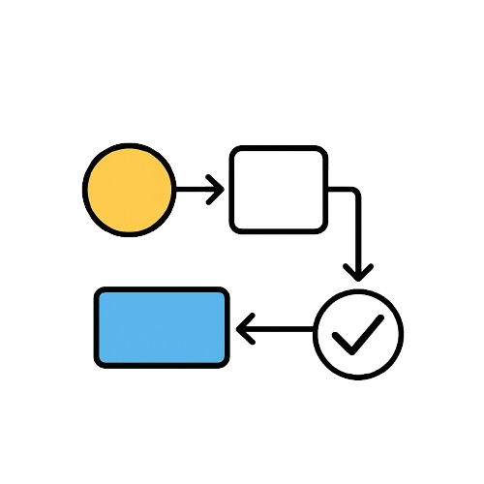
03
Workflow

Slide 8
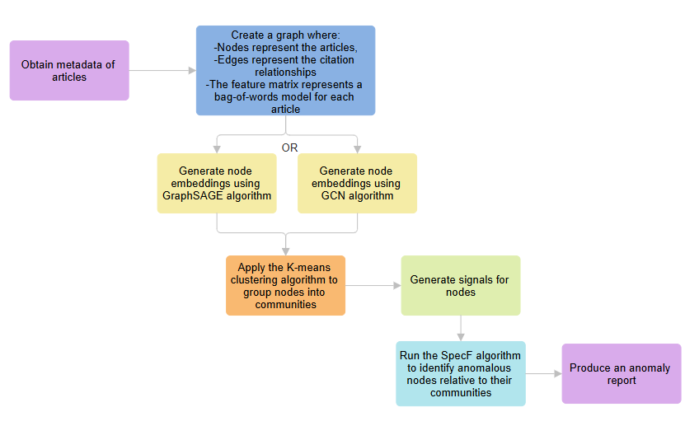

Slide 9
Data Preprocessing
Purpose:
Steps:
Transform raw article data into a structured, noise-free format suitable for graph embedding using GCN/GraphSAGE, clustering using K-means, and anomaly detection using SpecF.
Collect articles metadata
Build the Graph
Clean the Graph
Extract Node Features - Bag of words

Slide 11
Graph Embedding with GCN
What is GCN?
GCN stands for Graph Convolutional Network. It is a type of neural network designed to operate on graph-structured data.
Purpose:
The primary purpose of GCN is to learn node representations (embeddings) by aggregating information from neighboring nodes in a graph.

Slide 12
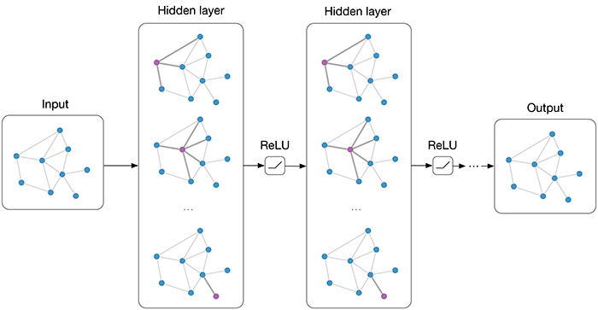
Graph Embedding with GCN
Steps (High-Level):
Adds self-loops (every node is connected to itself) to include each node's own features during aggregation.
Normalizes the adjacency matrix to balance feature contributions.
Aggregates neighbor features through matrix multiplication with the normalized adjacency matrix.
Applies non-linear activation function and update node representations.

Slide 13
Graph Embedding with GraphSAGE
What is GraphSAGE?
GraphSAGE (Graph Sample and Aggregate) is a graph neural network framework that improves upon earlier methods like GCN by introducing inductive learning - meaning it can generate node embeddings for unseen nodes or graphs, which GCNs typically cannot do directly.
Purpose:
Learn a function that can generate node embeddings by sampling and aggregating features from a node’s local neighborhood.

Slide 14
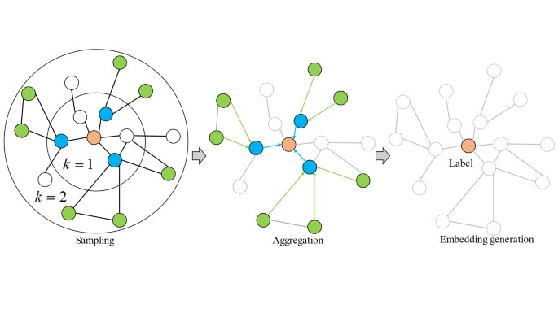
Graph Embedding with GraphSAGE
Steps (High-Level):
Samples a fixed number of neighbors for each node.
Aggregates their features using functions like mean or max pooling.
Combines aggregated features with the node’s own features.
Applies a non-linear activation function and update node representation.

Slide 16
K-Means Clustering
What is K-Means?
K-means is an unsupervised clustering algorithm that groups node embeddings) into K clusters based on their similarity.
Purpose:
To group nodes into communities by clustering their embeddings based on feature similarity, providing a structural basis for context-aware anomaly detection.

Slide 17
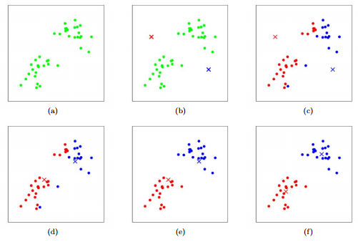
K-Means Clustering
Steps (High-Level):
(b) - Randomly choose 𝐾 cluster centroids.
(c) - Assign each node embedding to the nearest centroid.
(d) - Recalculate centroids as the mean of all points in each cluster.
(f) - Iterate assignment and update steps until centroids stop changing.

Slide 19
Signal Generation
What is Signal Generation?
Steps (High-Level):
Signal Generation creates node signals based on community structures in the graph.
Compute community-level signals.
Assign signals to high-degree nodes (community heads).
Propagate signals through the network with community-aware weights.
Normalize node signals considering edge weights to neighbor nodes by carrying weighted average.
Purpose:
Assign a meaningful, smooth signal to each node, reflecting community structure.

Slide 20
Anomaly Injection
What is Anomaly Injection?
Steps (High-Level):
Anomaly Injection simulates abnormal behavior by increasing signal values of selected nodes beyond their community norms.
Select a random subset of nodes as anomalies.
For each, find the maximum signal in their community.
Increase their signal by a random factor above this maximum.
Output the modified signal vector with injected anomalies.
Purpose:
Create known anomalies for testing and evaluating the accuracy of anomaly detection algorithms.

Slide 22
SpecF – Spectral Filtering for Anomaly Detection
What is SpecF?
Steps (High-Level):
An unsupervised method based on graph signal processing, which applies a low-pass spectral filter to highlight nodes that disrupt smooth community-level patterns.
Apply Graph Fourier Transform to convert node signals into the frequency domain.
Use a low-pass filter to smooth signals and remove high-frequency (anomalous) components.
Compare original and filtered signals, then use community-based thresholds to identify anomalous nodes.
Purpose:
To detect anomalies by identifying nodes whose feature signals deviate from the expected smoothness within their own community.

Slide 24
Anomaly Report
Purpose:
Summarize and present the results of the anomaly detection process in a clear, actionable format.
What the Anomaly Report Contains:
List of detected anomalous nodes.
Node details (article title, community, Deviation Score, etc..)
Summary of anomalous nodes per community, highlighting which communities show more anomalies.

Slide 25

04
Insights and Applications

Slide 26
Insights and Applications
Insights
Applications
Spectral filtering uncovers subtle signal disruptions not visible through raw features alone.
Embedding-based clustering allows flexible, scalable handling of complex graphs.
The modular design (Embedding → Clustering → Filtering) enables adaptability across domains.
Cybersecurity - Detect suspicious behavior within internal network segments.
Fraud Detection - Identify anomalies in transaction or account networks.
Social Media - Find bots or malicious users based on community dynamics.
Smart Cities / IoT - Flag malfunctioning or abnormal sensors in smart infrastructure.

Slide 27

05
Testing Plan

Slide 28
Testing Plan
 | Expected Results | Test Description | Component
1 | Clean graph with valid structure | Ensure that CitationNetwork removes duplicates and self-citations and produces the correct node-feature structure | CitationNetwork
2 | Valid embedding vectors | Verify that the embeddings generated using either use_gcn() or use_graphsage() are correctly shaped and non-empty | GraphEmbeddingGenerator
3 | Embeddings match input size | Ensure the number of embeddings equals the number of nodes provided in CitationNetwork | GraphEmbeddingGenerator
4 | Nodes clustered into expected number of groups | Validate that KMeans assigns a cluster label to each node and respects the defined number_of_clusters | KMeansClustering
5 | Expanded matrix constructed correctly | Check that the construct_expanded_matrix() method in SpecFProcessor builds a matrix using the fixed weights defined for edge and community relationships | SpecFProcessor

Slide 29
Thank You for your attention ☺
Shai & Itay

